Slide 1
Endtest Analysis and Recommendations
Austin Ibele

Slide 2
Agenda
Limitations
Overview of Recommendations
Detailed Recommendations
Future Directions

Slide 3
Limitations
Data on product defects scarce
Products not designed for stand-alone testing
Manual process
Future reference: * = my task

Slide 4
Immediate Recommendations
Collect Data
Document Processes!* (in progress)
End duplicate temperature display calibration
2nd visual check/sign-off before packaging
Electric Screwdriver
New temperature uniformity protocol to reduce human error*
New packing lists checked by multiple “experts”
Doc Generator V2

Slide 5
Near-term Recommendations
Consider separate individual for packing/shipping/system inspection
Computerized Algorithm for determining Endtest tests*/
Built into Endtest Doc Generator?
Automate temperature uniformity test* (in progress)/
Automate label printing*/
Pipe data from Auftragslist/Validate Seriennummern XLS*/

Slide 6
Potential Recommendations
New Test Controllers for Chuck Department
Automate temperature display calibration
Eliminate kz for basic chucks
Change steps protocol
Write program to detect steps abnormalities*/
CE/UTL Prüfprotokoll only when required

Slide 7
Detailed Immediate Recommendations

Slide 8
Collect Data
What:
Record all defects found in testing
Save all test data
Why:
Aid Root Cause Analysis
Aid process optimization
Assess process changes

Slide 9
Document processes
What:
Record process steps
Create SOP (NO ACRONYMNS standard operating procedure)
Why:
So other workers can perform Endtest duties
Aid in process analysis

Slide 10
End duplicate temperature display calibration
What:
Stop performing temperature display calibration in Endtest
Why:
Temperature display is already performed by Chiller/Controller department
PT100 simulators have imperfect interunit repeatability
Negligible impact to customers

Slide 11
2nd visual check/sign-off
What:
Add visual system inspection to duties of Lager/upstairs worker
Sign off on visual condition of all systems
Perform prior to packaging
Why:
This issue a common and inexcusable issue

Slide 12
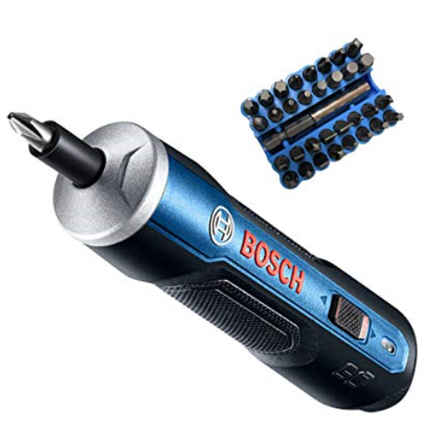
Electric Screwdriver
What:
Electric screwdriver
Can be applied to all departments (even small electronics)
Why:
Partial disassembly often required for fixing/trouble-shooting
Can be time consuming
Notes:
https://www.amazon.com/DEWALT-DCF682N1-Gyroscopic-Inline-Screwdriver/dp/B011WRUODC/ref=cm_cr_arp_d_product_sims?ie=UTF8
https://www.amazon.com/DEWALT-DWAX100-Screwdriving-Set-31-Piece/dp/B00C1XZITM/ref=cm_cr_dp_d_rvw_txt?ie=UTF8
https://www.amazon.com/Adjustable-Cordless-Screwdriver-Rechargeable-Precision/dp/B07K77QC6K/ref=sr_1_21?crid=2LI4H4SPWSHC3&keywords=precision+cordless+screwdriver&qid=1551949925&s=gateway&sprefix=precision+cordle%2Caps%2C207&sr=8-21

Slide 13
New temperature uniformity protocol to reduce human error*
What:
Add space to enable larger handwriting
Tablet??
Why:
More legible
Less reading errors

Slide 14
New packing lists checked by multiple “experts”
What:
Double check all new packing lists before input into SAGE, again in production
Why:
Many delivery errors
Missing/incorrect items on packing list often direct cause
Insert pictures

Slide 15
Doc Generator V2
What:
“Alle Zusamen” single PDF
??
??
Why:
Easier for printing
Illustration… also document more on what this does/etc,
Notes:
Suffix CH on end of order – need to discuss

Slide 16
Detailed Future Recommendations

Slide 17
Consider separate individual for packing/shipping/system inspection
What:
2 people… explain more (1 does this , the other that)
Separate employee to inspect, pack, and prepare shipping
Why:
Endtest worker already “familiar” with system
Greater specialization of labor = greater accuracy/efficiency

Slide 18
Computerized Algorithm for determining Endtest tests*
What:
Programmatically construct algorithm that specifies tests
Can be added onto my program “Endtest Doc Generator”
Basically a “check list” (print every time with program)
SAGE!!!!!!!!!
Why:
Required tests often missing
Unneeded tests performed
Can be more accurate than a human
Saves time

Slide 19
Automate temperature uniformity test* (in progress)
What:
Combine Hz/Kz with steps for new automated protocol
Use Autolog function of Sensarray system
Programmatically evaluate uniformity and system performance later
Why:
Can now perform Hz/Kz and uniformity tests overnight
Save time and reduce error

Slide 20
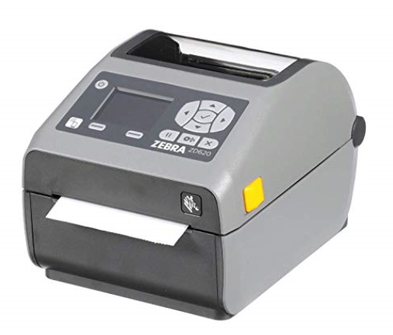
Automate label printing*
What:
Print labels with Seriennummern spreadsheet data OR require double entry of SSN
Zebra brand high resolution thermal-transfer printer
High temperature labels
Why:
Incorrect SSN on label is common problem
Saves time by changing tedious task
Zebra ZD620, ~ $570

Slide 21
Pipe data from Auftragslist/Validate Seriennummern XLS
What:
Directly transfer certain data from Auftragsliste to Seriennummern XLS
Eliminate certain input errors via Macros
Why:
Auftragsliste generally more accurate
Reduces human input steps
Constrains human input

Slide 22
Detailed Potential Recommendations

Slide 23
New Test Controllers for Chuck Department
What:
New/upgraded controllers for chuck department with most recent PID values
Replace Uberschwing test with different test to find bad PT100 placement
Heat to 50C and control, heat to 80C and control
Computer/monitor needed
Teach Chuck Department AC3R2 test software (easy)
Why:
Uberschwing test is not sensitive
Nuhan commonly finds bad PT100 placement in Endtest
Often not noticed until steps

Slide 24
Automate temperature display calibration
What:
New test program that cycles controller/chiller every 5-10s, etc
Program records displayed PT100 temperature value
Using internally stored PT100 simulation data, program fits test data to curve and subsequently adjusts calibration values
Use test data to generate document
Why:
Display calibration is very tedious and time consuming

Slide 25
Eliminate kz for basic chucks
What:
Stop doing Kz for basic chucks
Replace with chiller air flow assessment
Gather cold-temp uniformity during steps
Add Hz to steps
Why:
Good thermal transfer from heating unit to top plate in basic chucks (few layers compared to ULN, for example)
Chillers more powerful than in the past
Out of spec Kz almost always from chiller problems
Chiller air flow rate proportional to cooling time

Slide 26
Change steps protocol
What:
Change duration or amount of steps
New step temperatures
Why:
Steps arbitrarily defined
Possible to increase steps test sensitivity if data-based

Slide 27
Write program to detect steps abnormalities*
What:
Program evaluates steps curves to look for abnormalities/instabilities
Why:
Possibly more accurate than human? (humans great at pattern recognition)
Save time printing out many graphs for documentation

Slide 28
CE/UTL Prüfprotokoll only when required
What:
Perform only for customers who require it
Why:
Wasted time
Keep doing this…
Change to conform with safey

